Slide 1
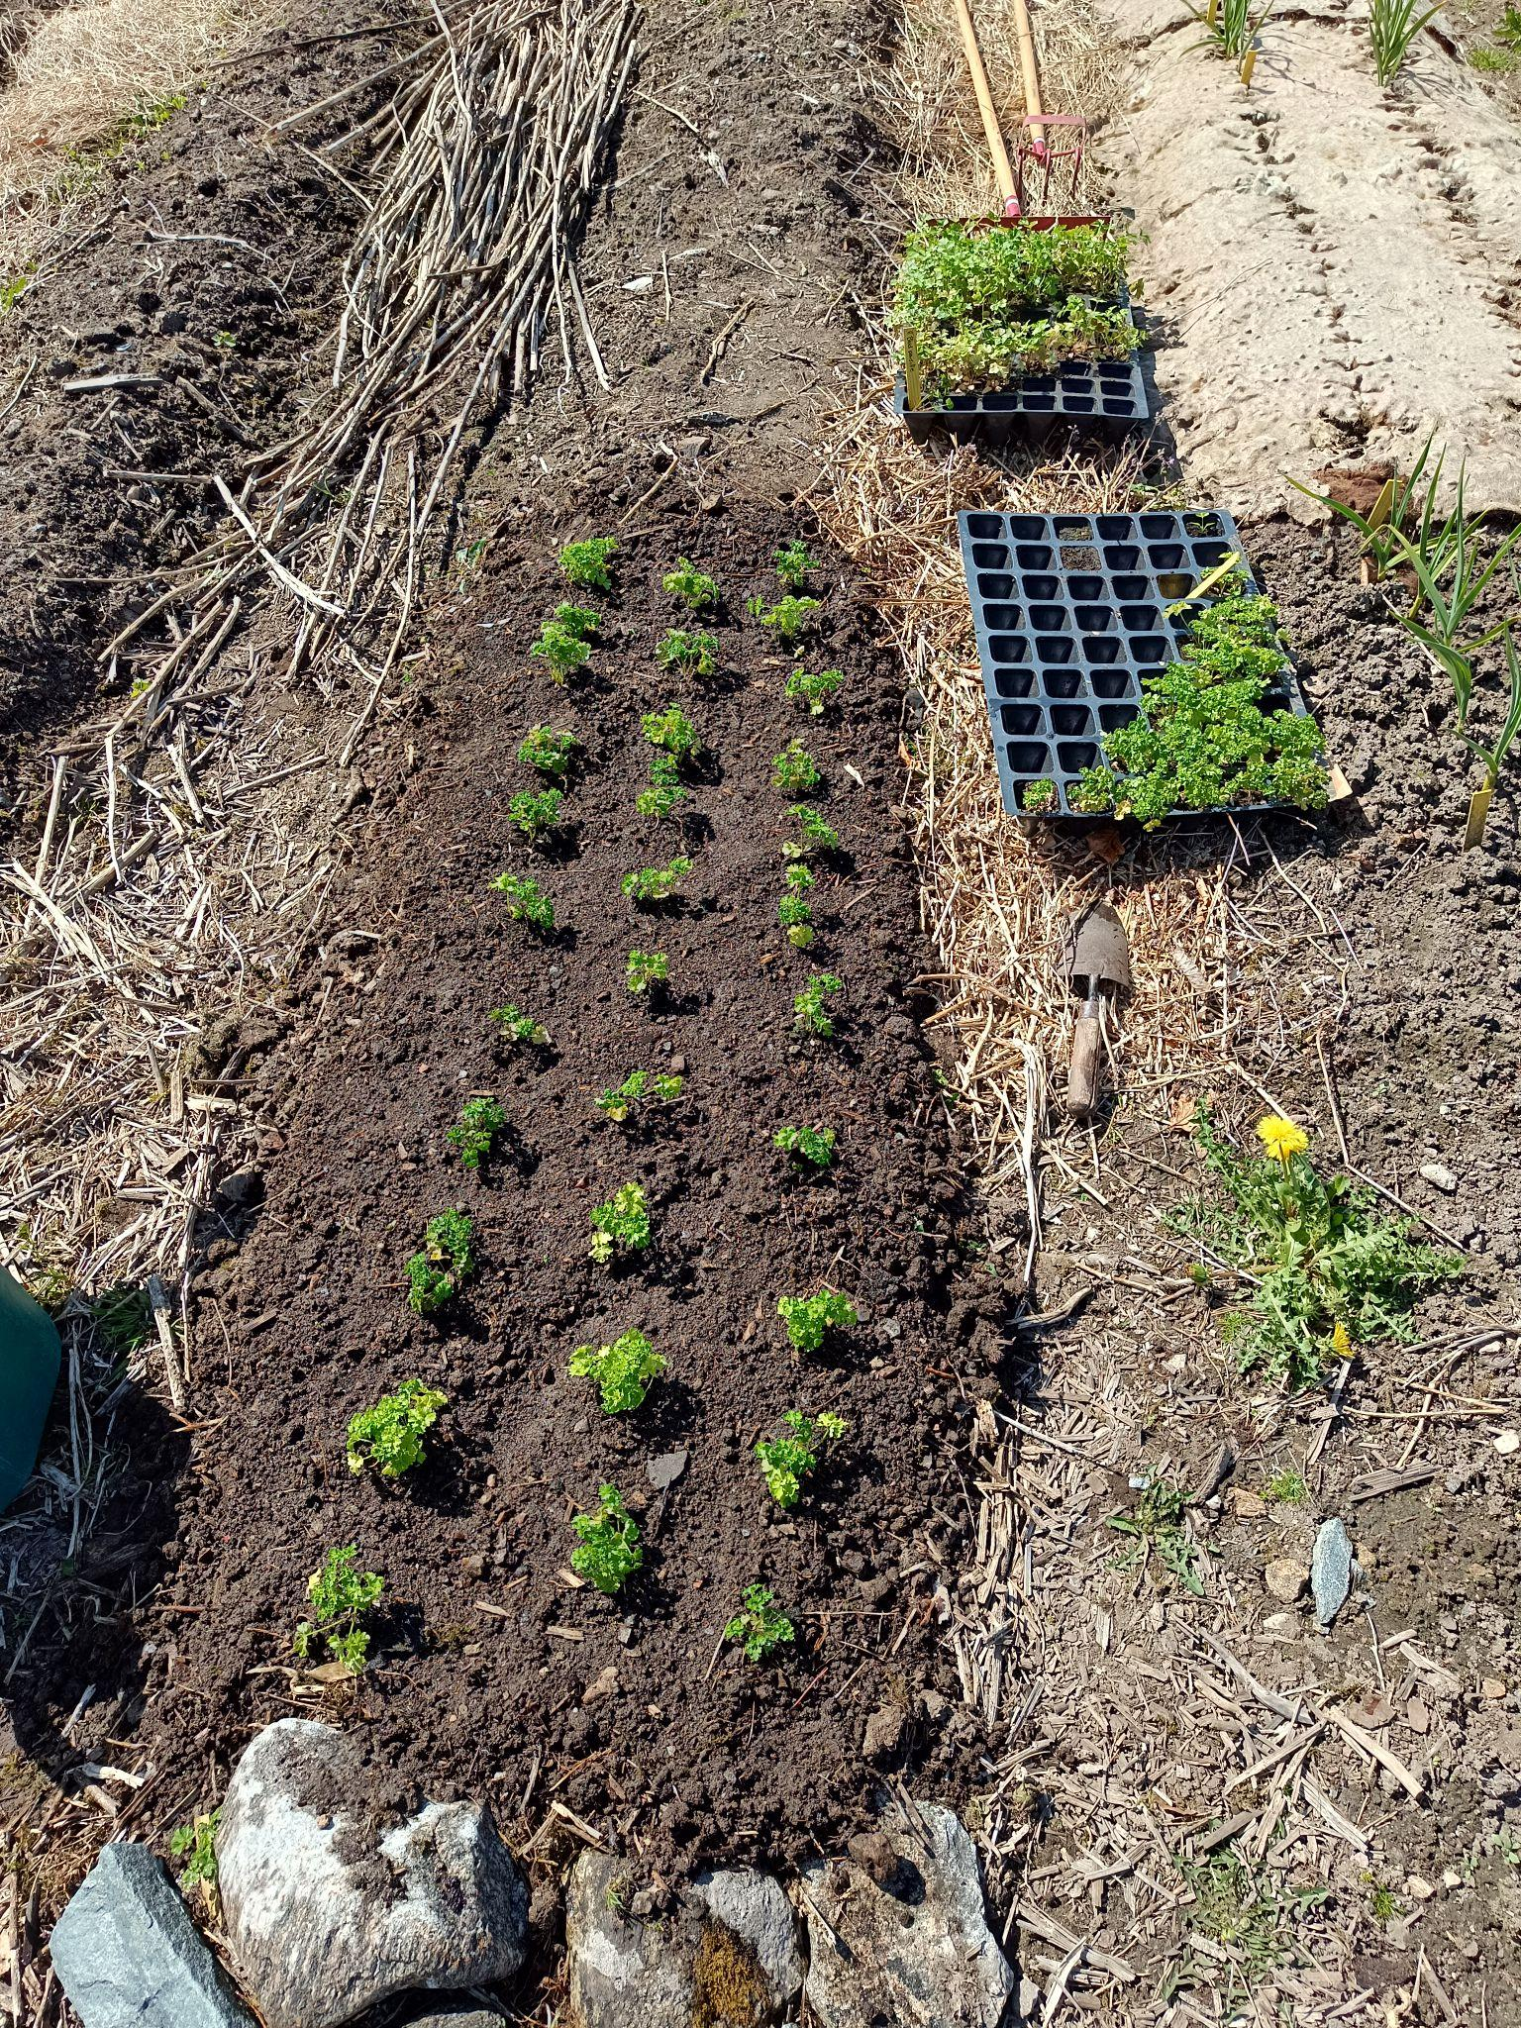
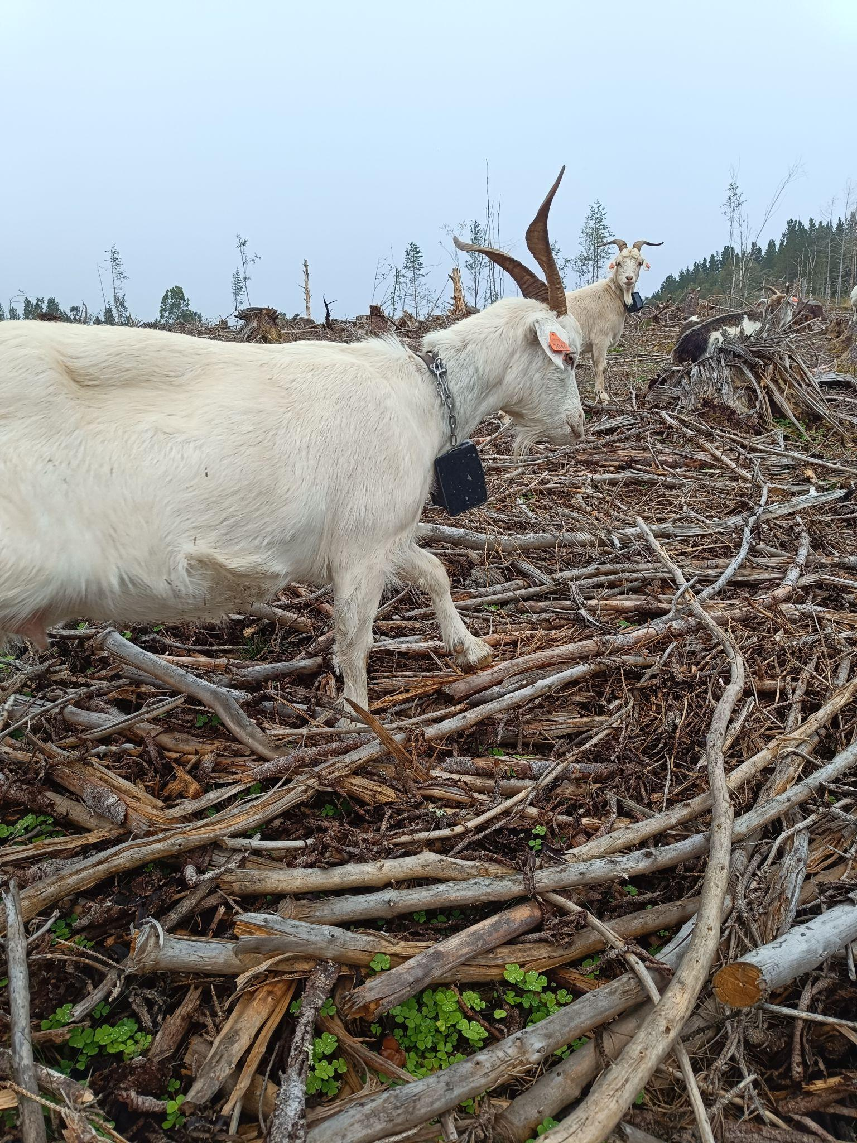
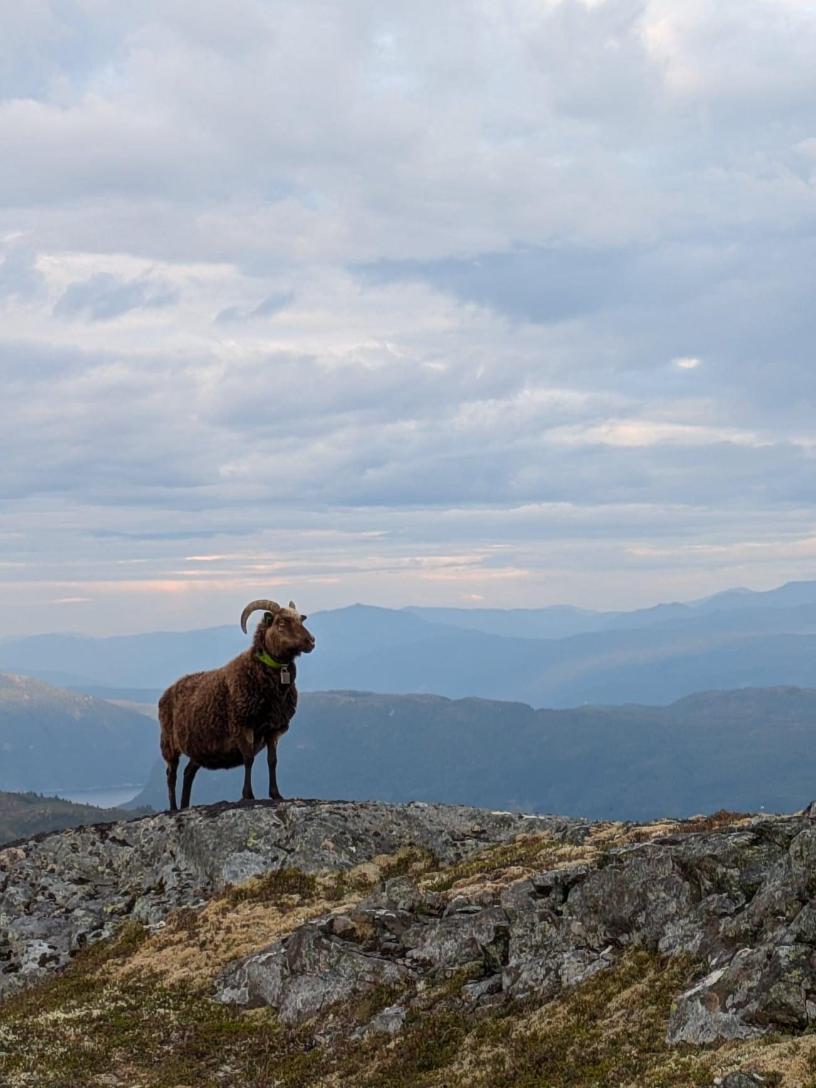
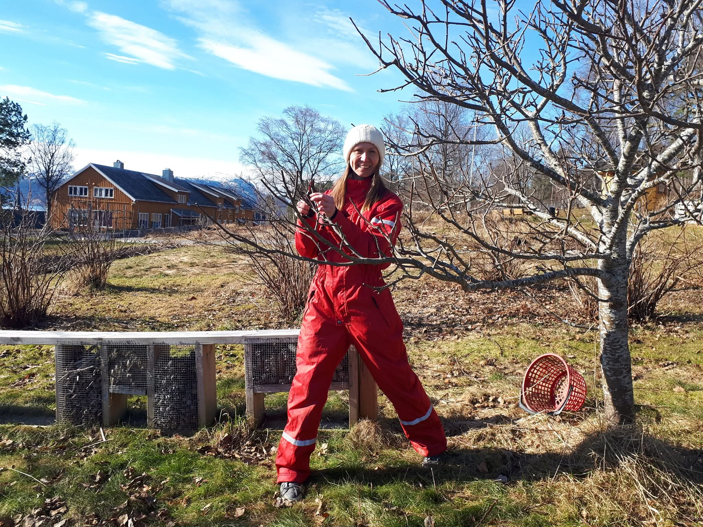
NorjordAI
an AI chat about
Norwegian Agriculture

Slide 2
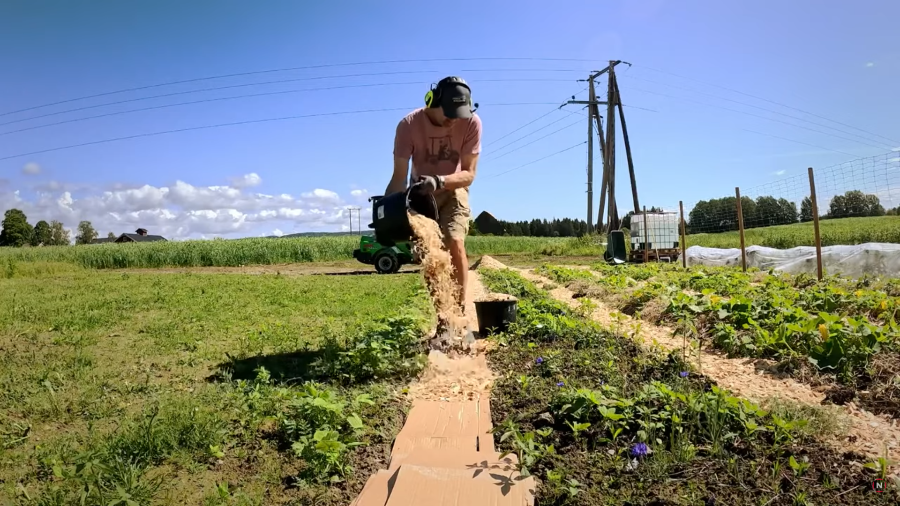
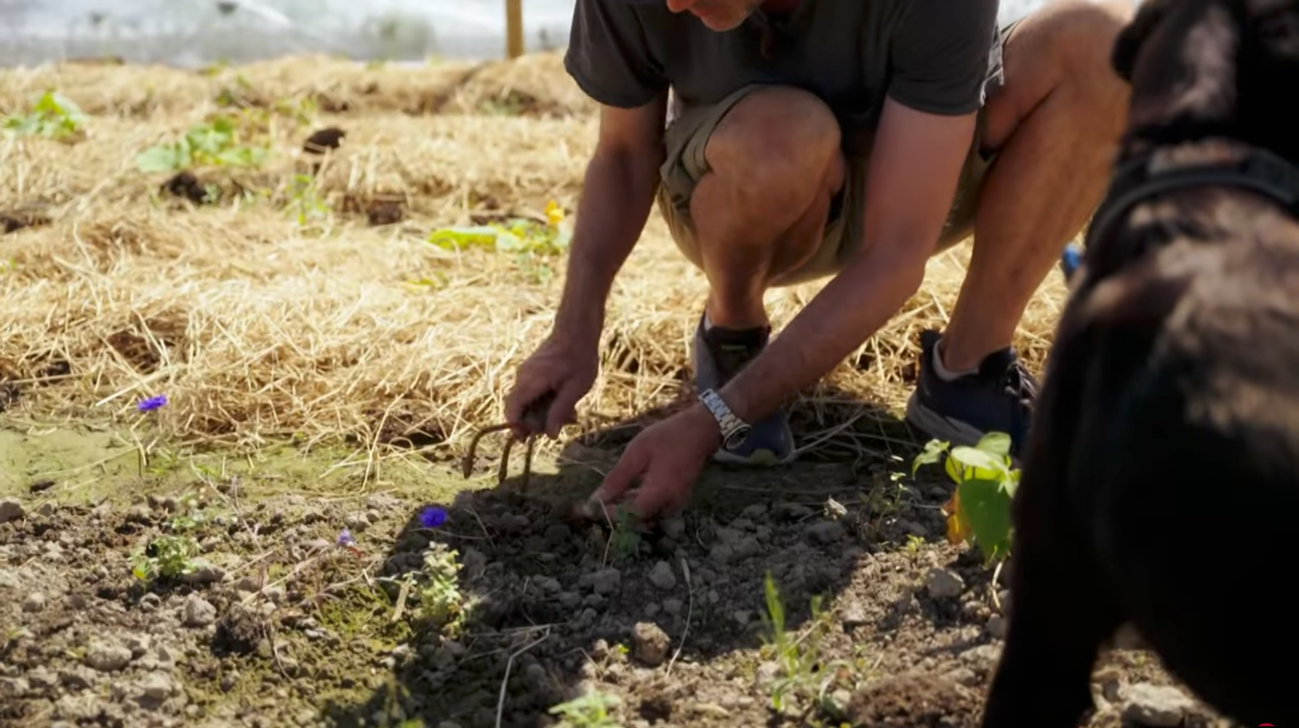
Farmers are busy

Slide 3
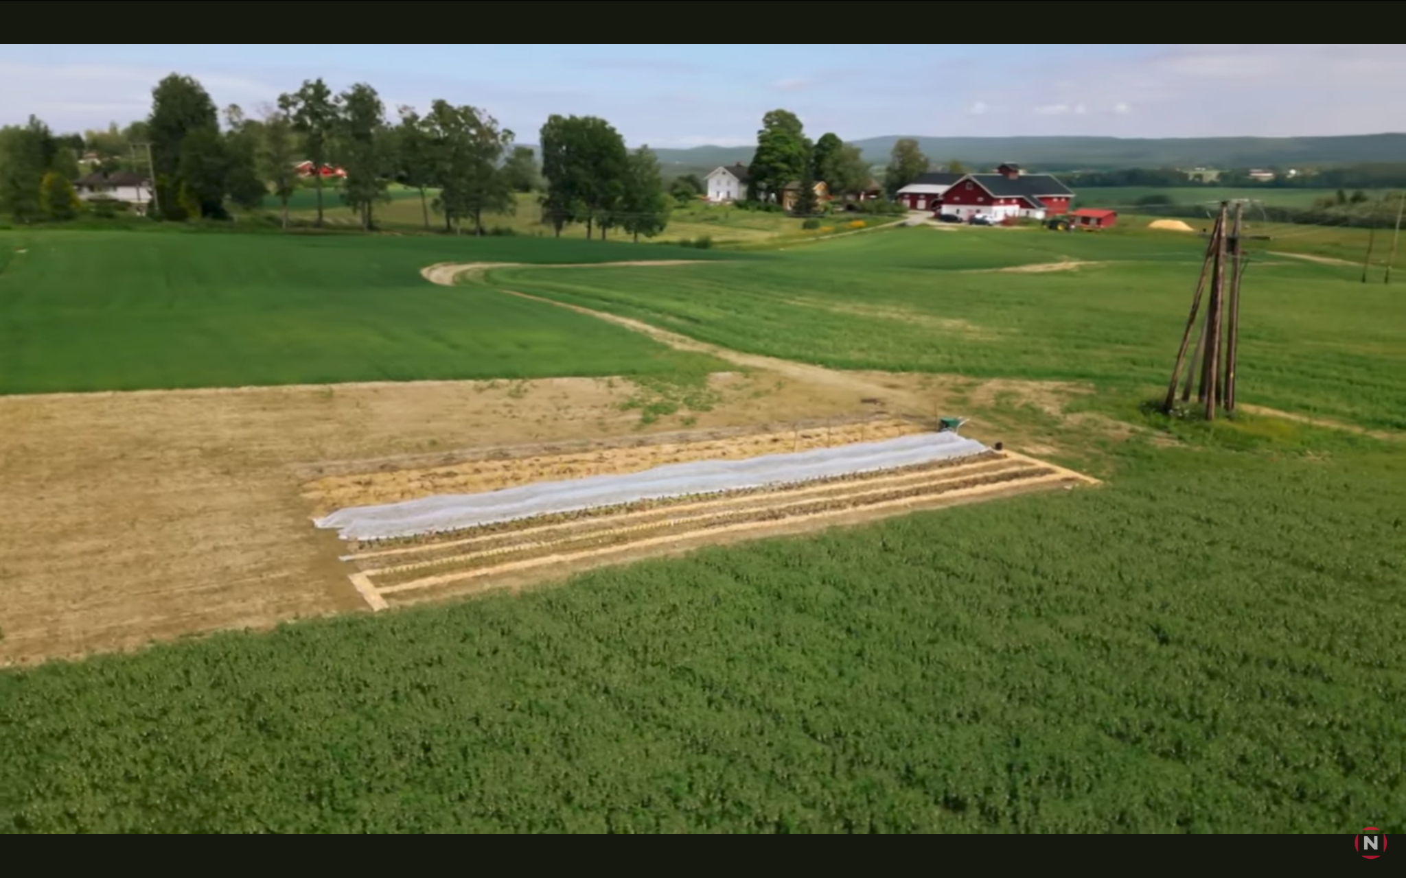
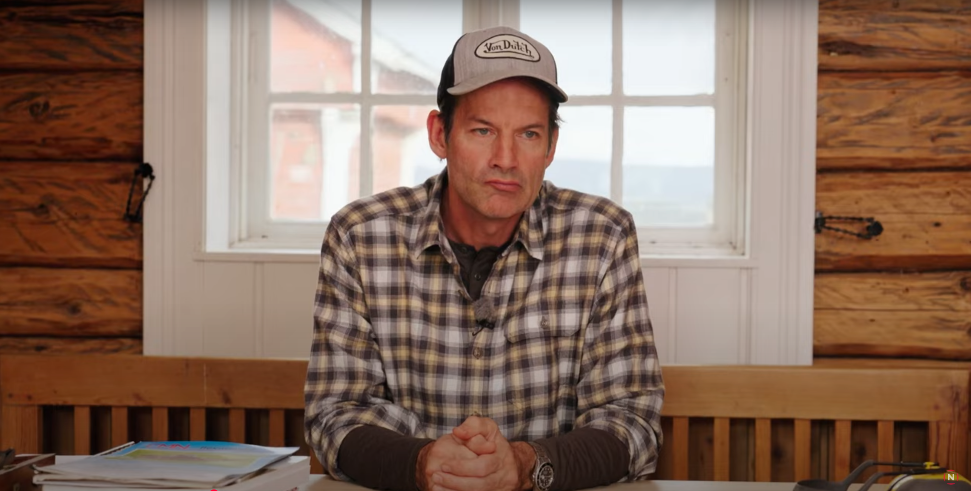
They need to make decisions

Slide 4
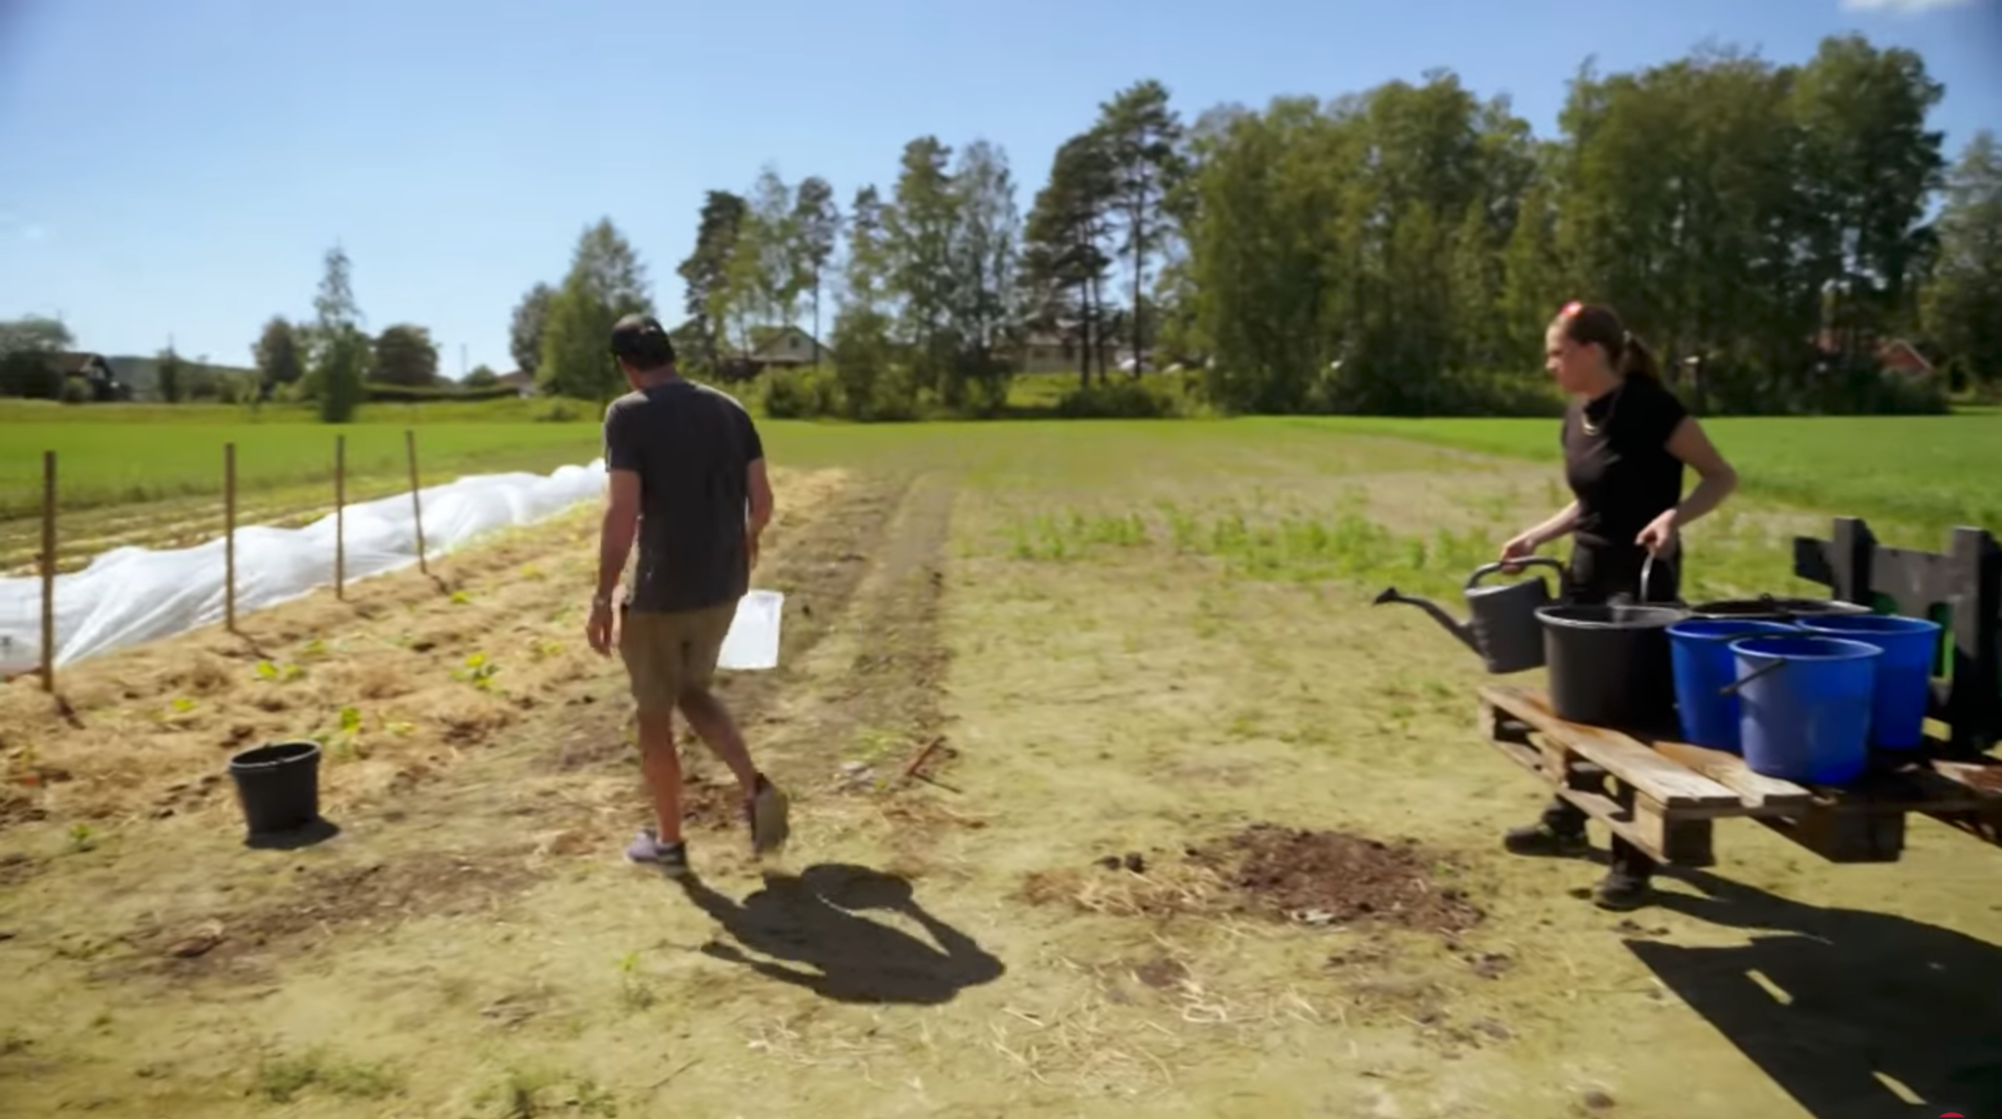

Why didn’t I plant vegetables near the river?..
And might face challenges

Slide 5
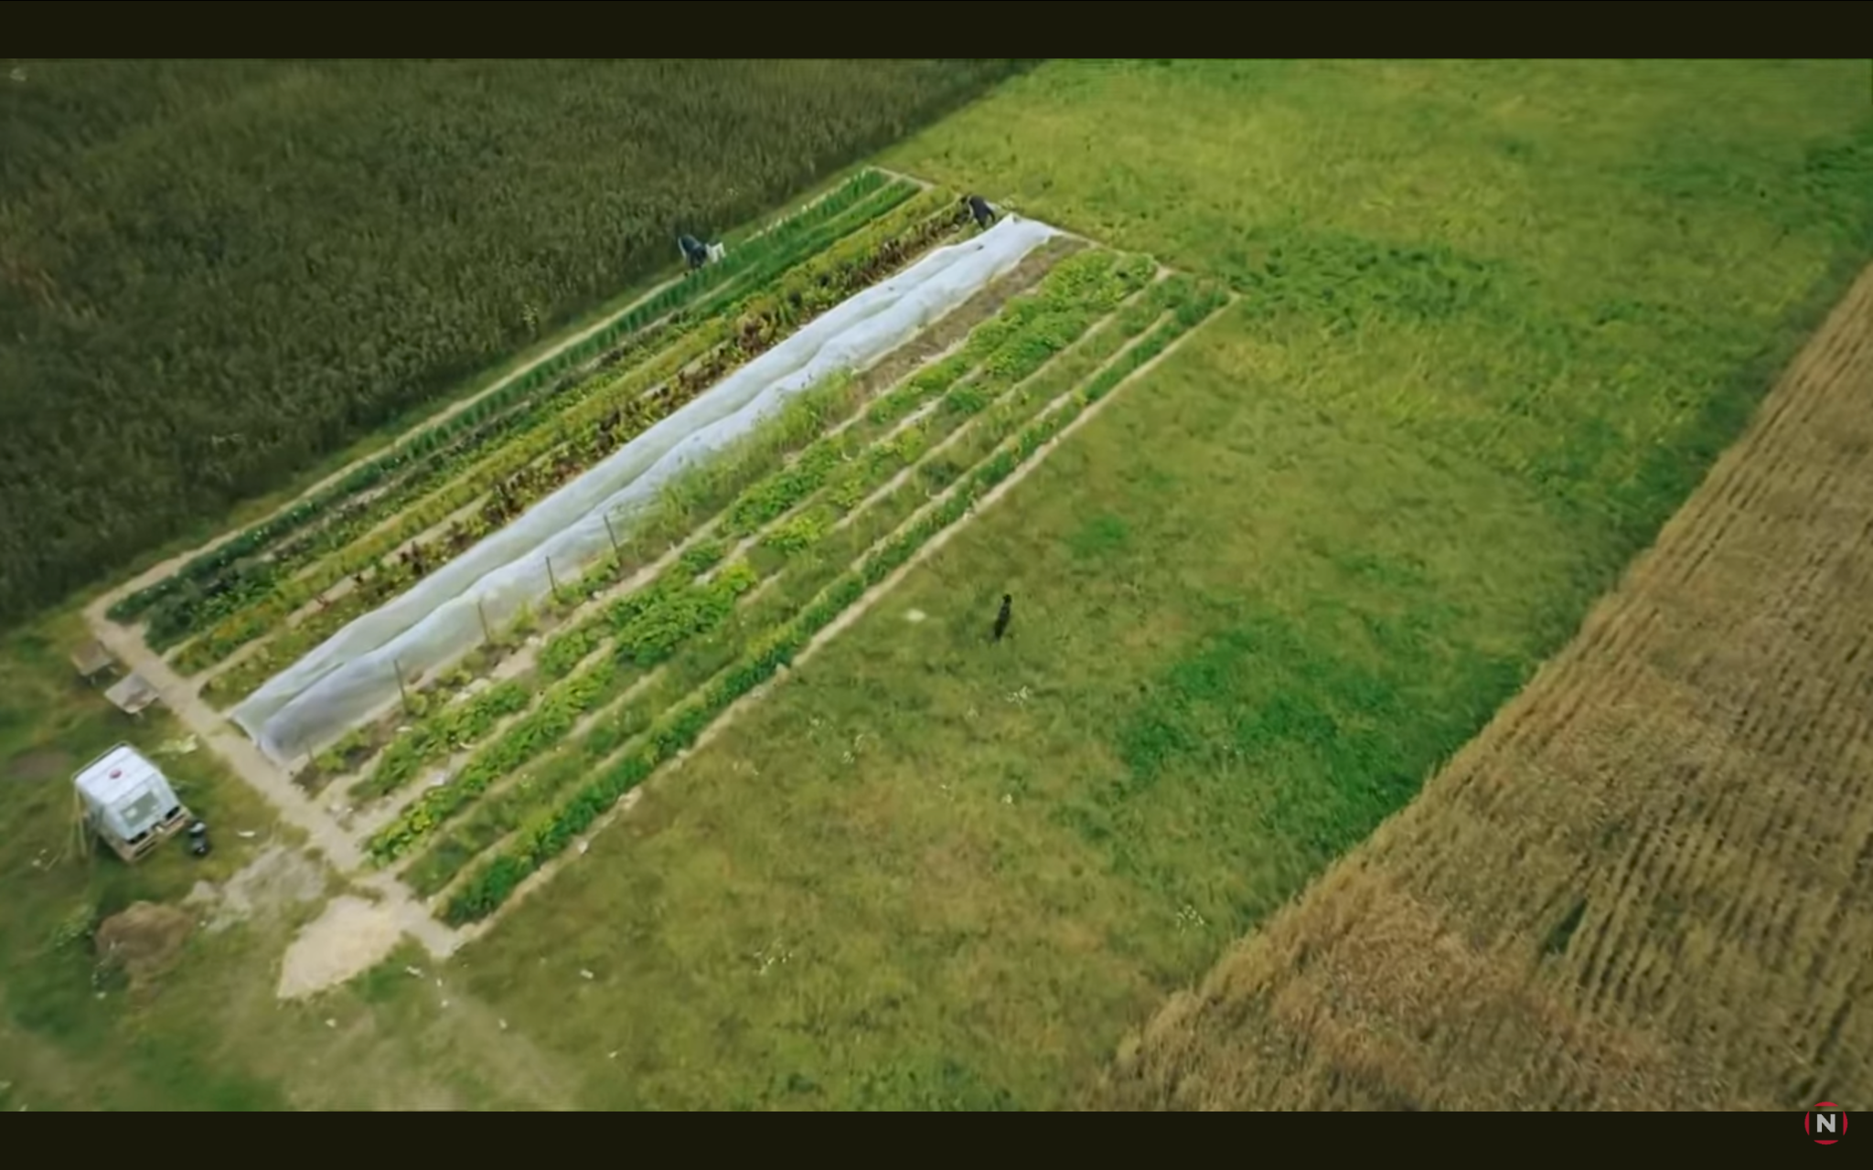
Jon blir bonder
The right solution can help farmers produce more food

Slide 6

AI-based advisor
in the form of a chat dialog
can assist with information timely utilizing:
recent research
local nuances
farmer’s preferences
environmentally friendly approaches
technological advancements
“Embracing Generative AI in Agriculture”

Slide 7
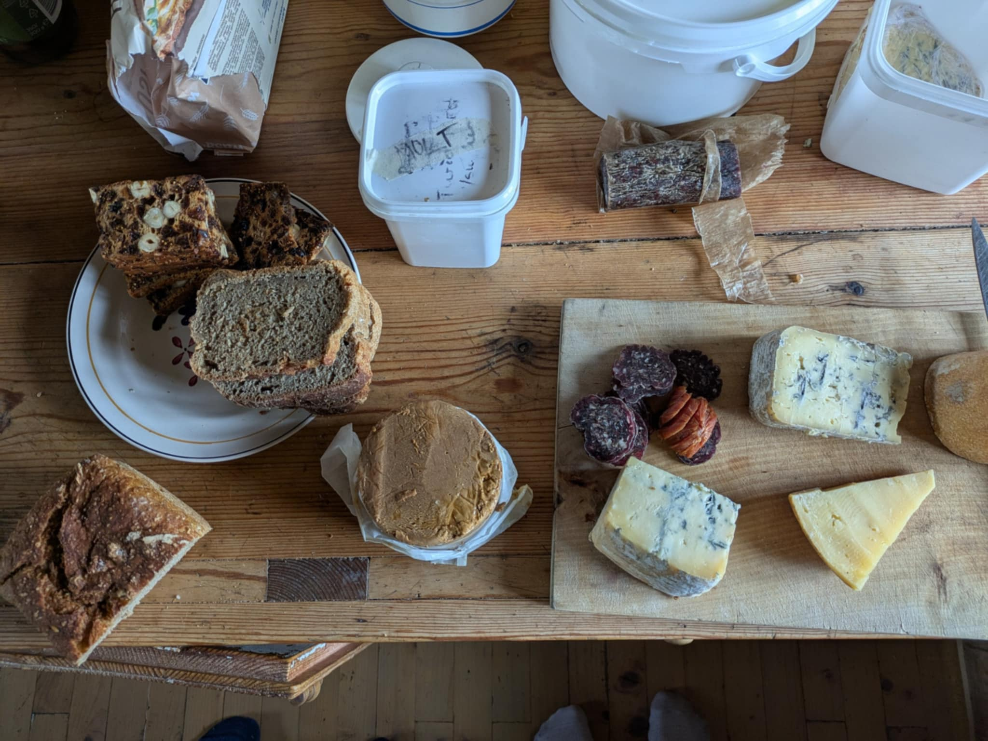
Benefits
that potentially lead to
easy to interact
fast access to information
personalised specific answers
knowledge based decisions
cost and resource optimization
higher quality products
increase of local food production
better environment
more food

Slide 8
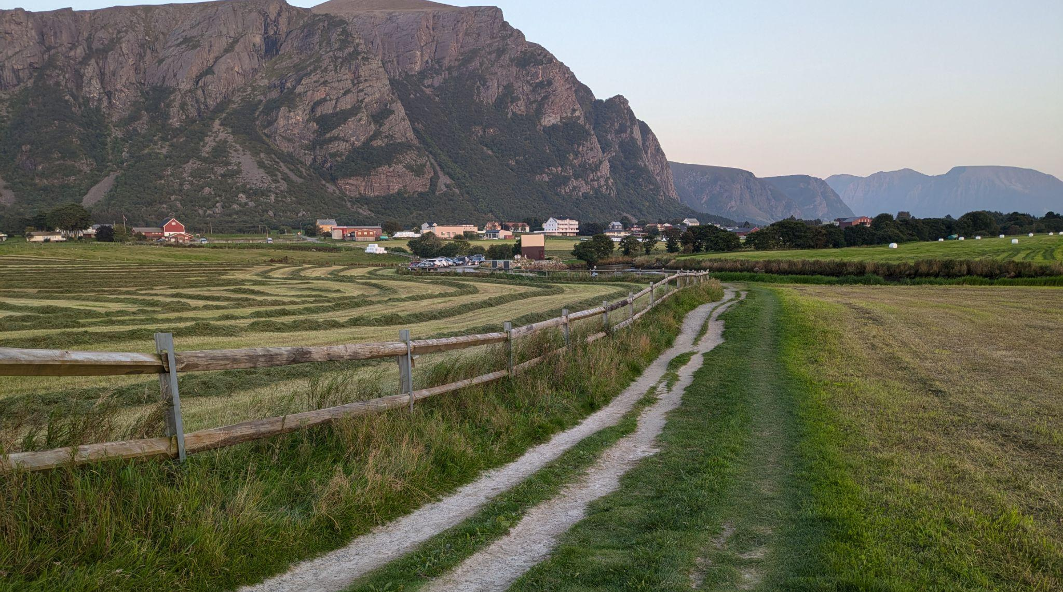
Agriculture in Norway
Grass-based livestock production is the backbone of Norwegian agriculture

Slide 9
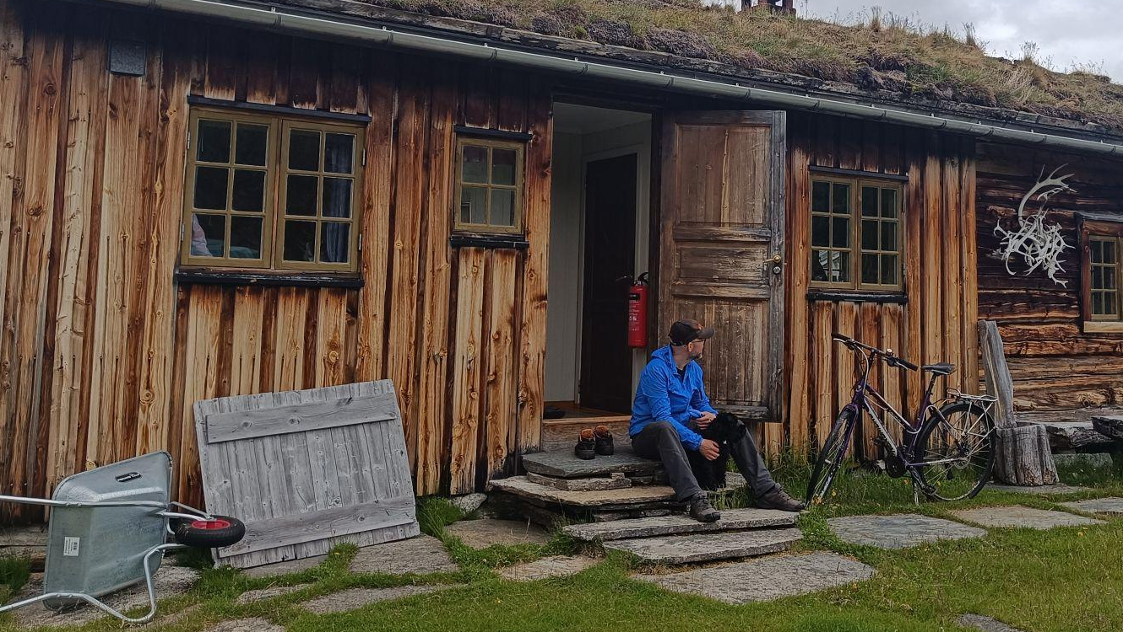
Topography, geology, and biology form the foundation for plant production, while climate and geography determine the types of crops that can be grown in specific areas.
"Norway has a marginal production area for many important crops and is one of the few European countries that cannot grow sugar".
When discussing Norwegian agriculture, it is important to consider the country’s northern location. Some parts of Norway are in the Arctic, which makes agriculture a challenging endeavour.
"Due to Norway’s climate, grain yields per hectare are lower than in most other European countries. In many parts of the country, growing fodder crops, mainly grass, is the only viable option."
One of the advantages of the cool climate is that it helps limit the spread of plant diseases and pests. These climatic and geographical conditions shape Norwegian agriculture. Soil, latitude, and climate are all interconnected
see more

Slide 10
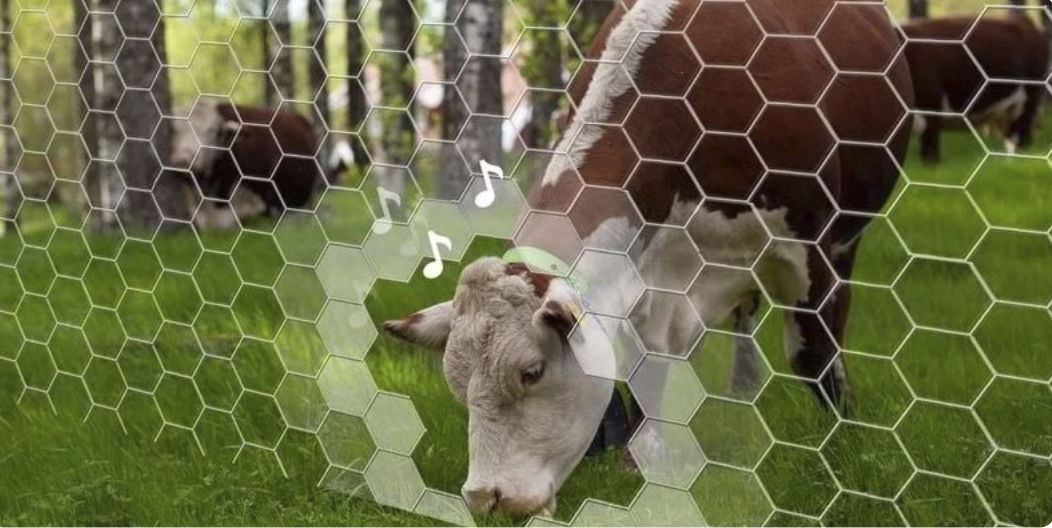
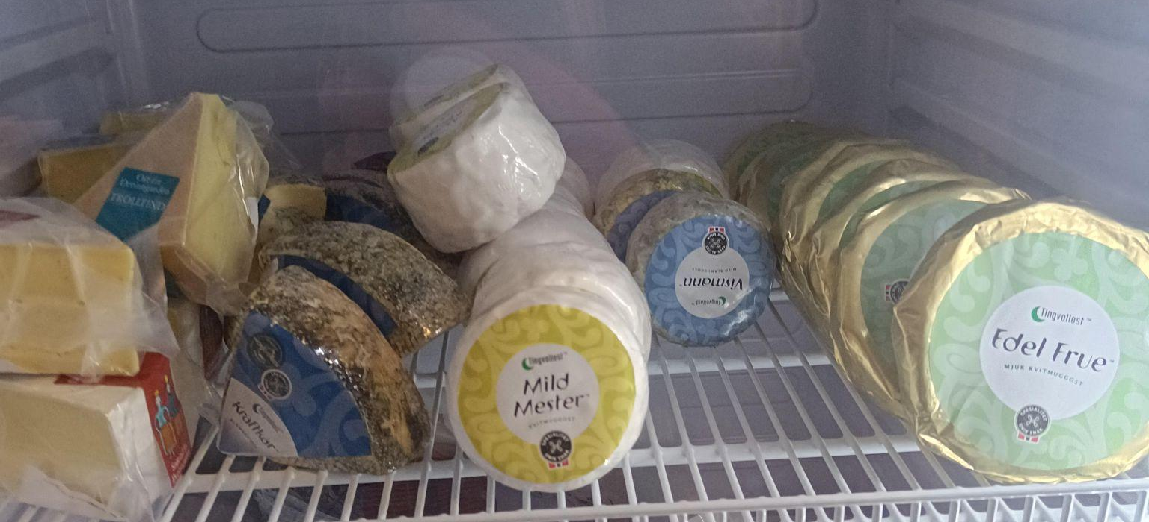
Norway's agricultural landscape, see more
Virtual fencing, see more
is undergoing a remarkable transformation
While milk consumption has halved over the past three decades, cheese and poultry have surged in popularity. Today, the average Norwegian consumes 19 kg of cheese and 20 kg of poultry annually - a staggering increase of 5 kg and 14 kg respectively since 1995.
Farmers need to follow regulations, changing market requirements and opportunities of new technologies.

Slide 11
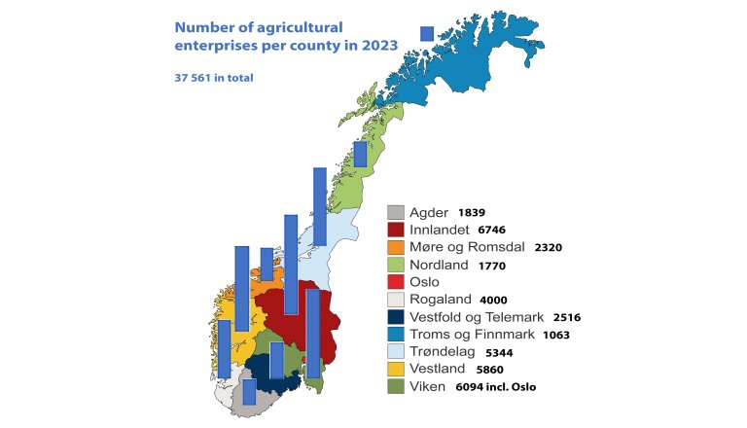
Estimates
* The image is from the article
“How much do Norwegian farmers earn?” of the NIBIO website

Slide 12
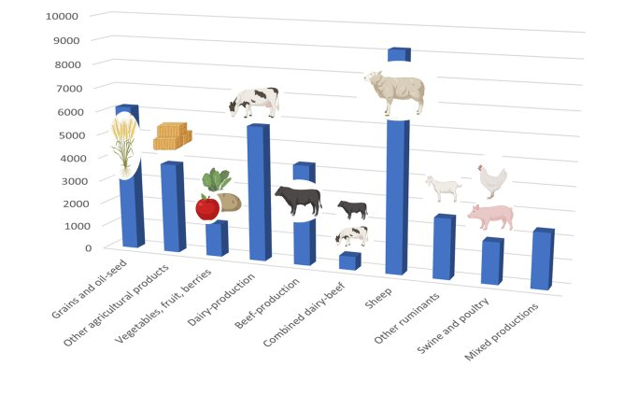
Number of agricultural enterprises per production
Fact
Consumption of meat has doubled in 40 years
* The image is from the article
“How much do Norwegian farmers earn?” of the NIBIO website

Slide 13
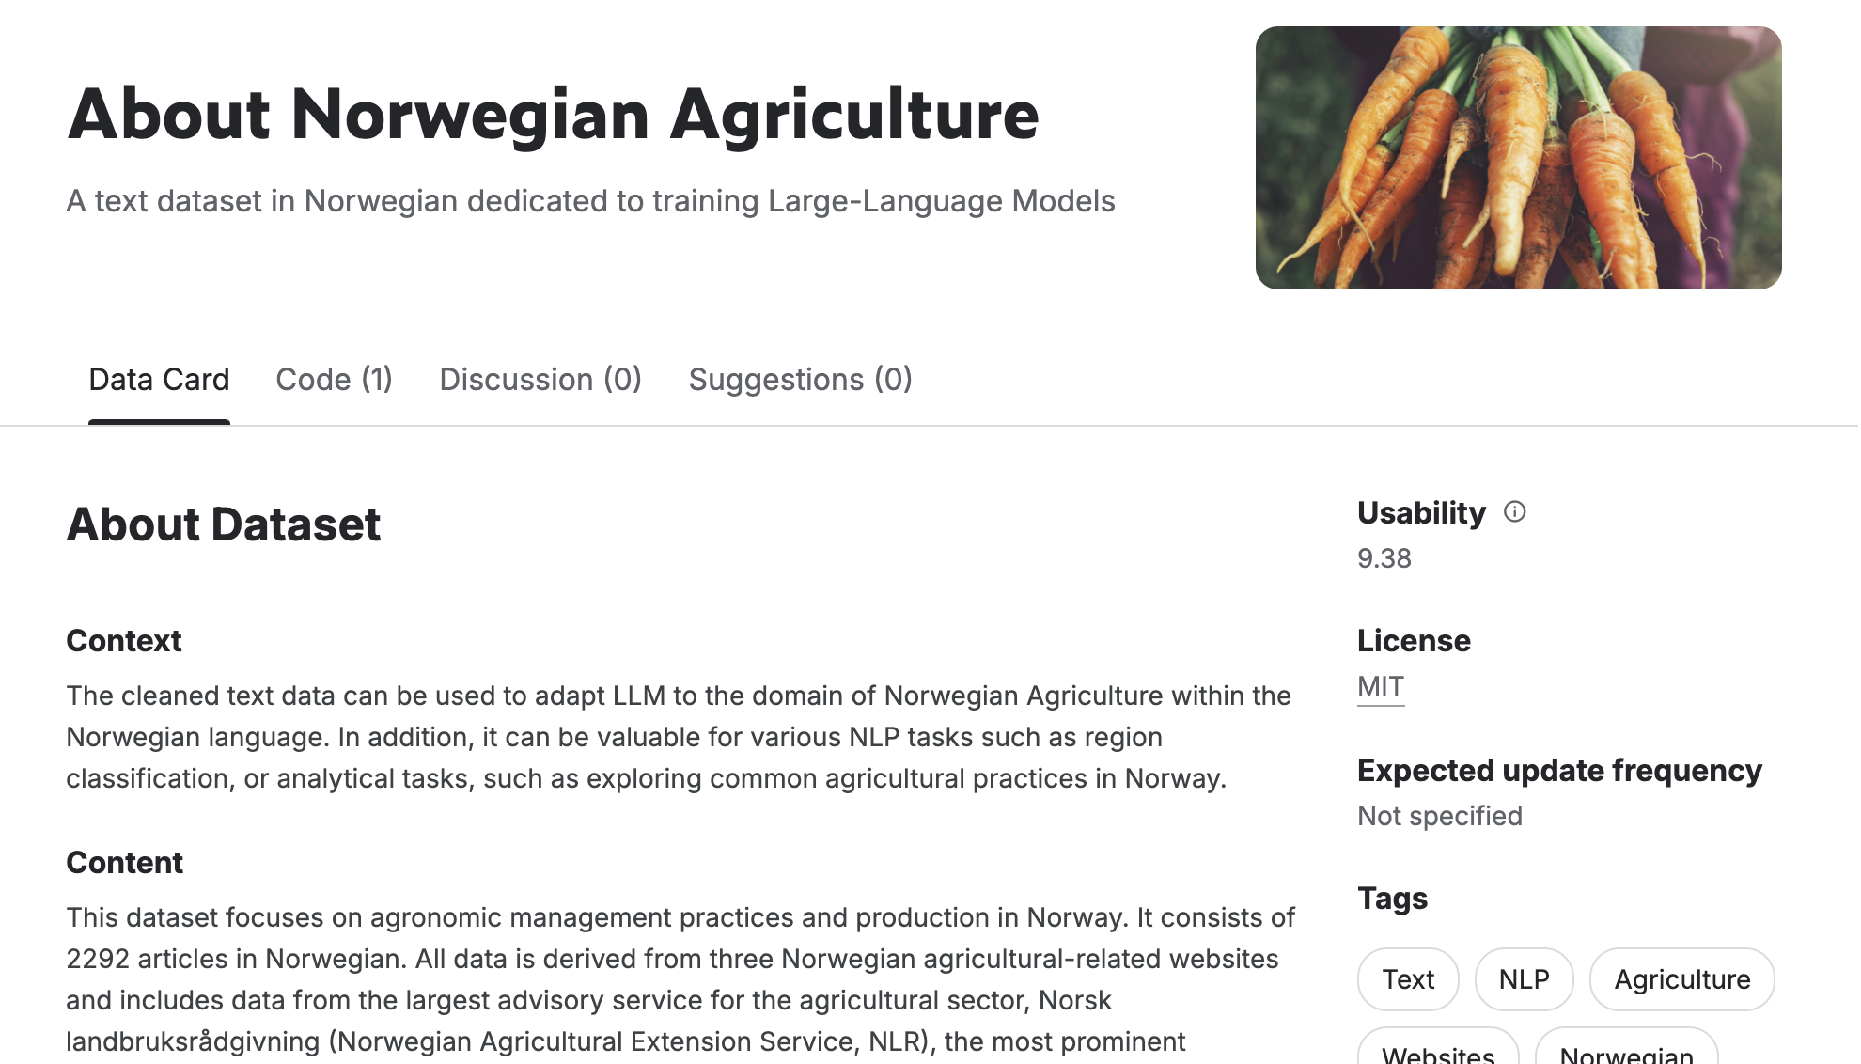
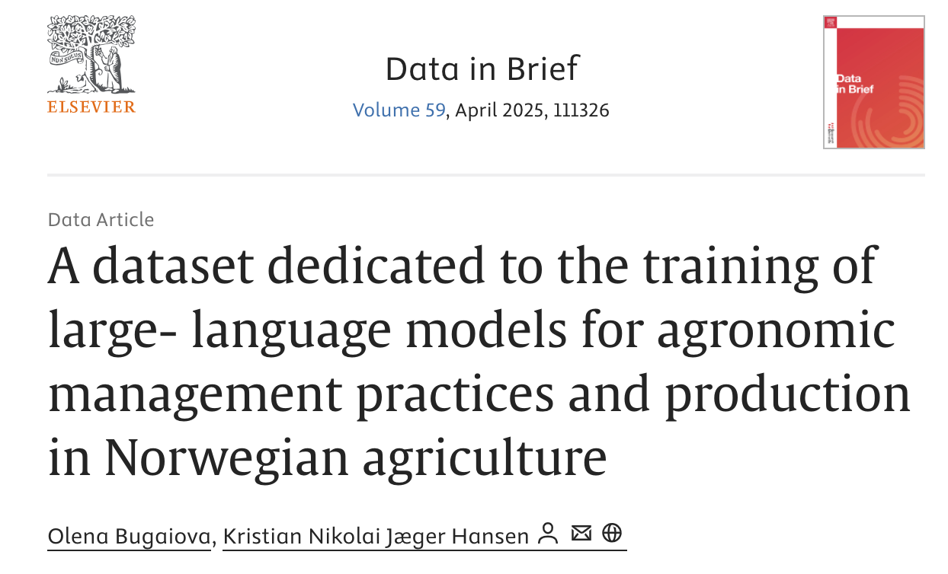
Previous work
Collected text data and shared on Kaggle
Described web scraping of the data by providing notebooks with code
Published a research paper: “A dataset dedicated to the training of large- language models for agronomic management practices and production in Norwegian agriculture”
Made a proof of concept by converting data into PDF files and adding it to notebookLM

Slide 14
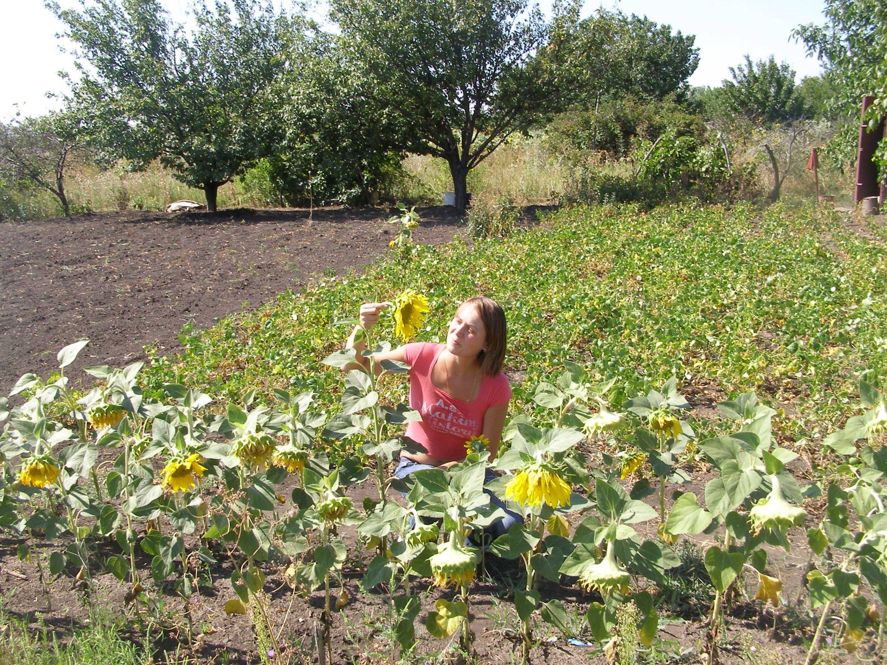
Garden experience
Since childhood I helped my parents in their garden in Ukraine

Slide 15
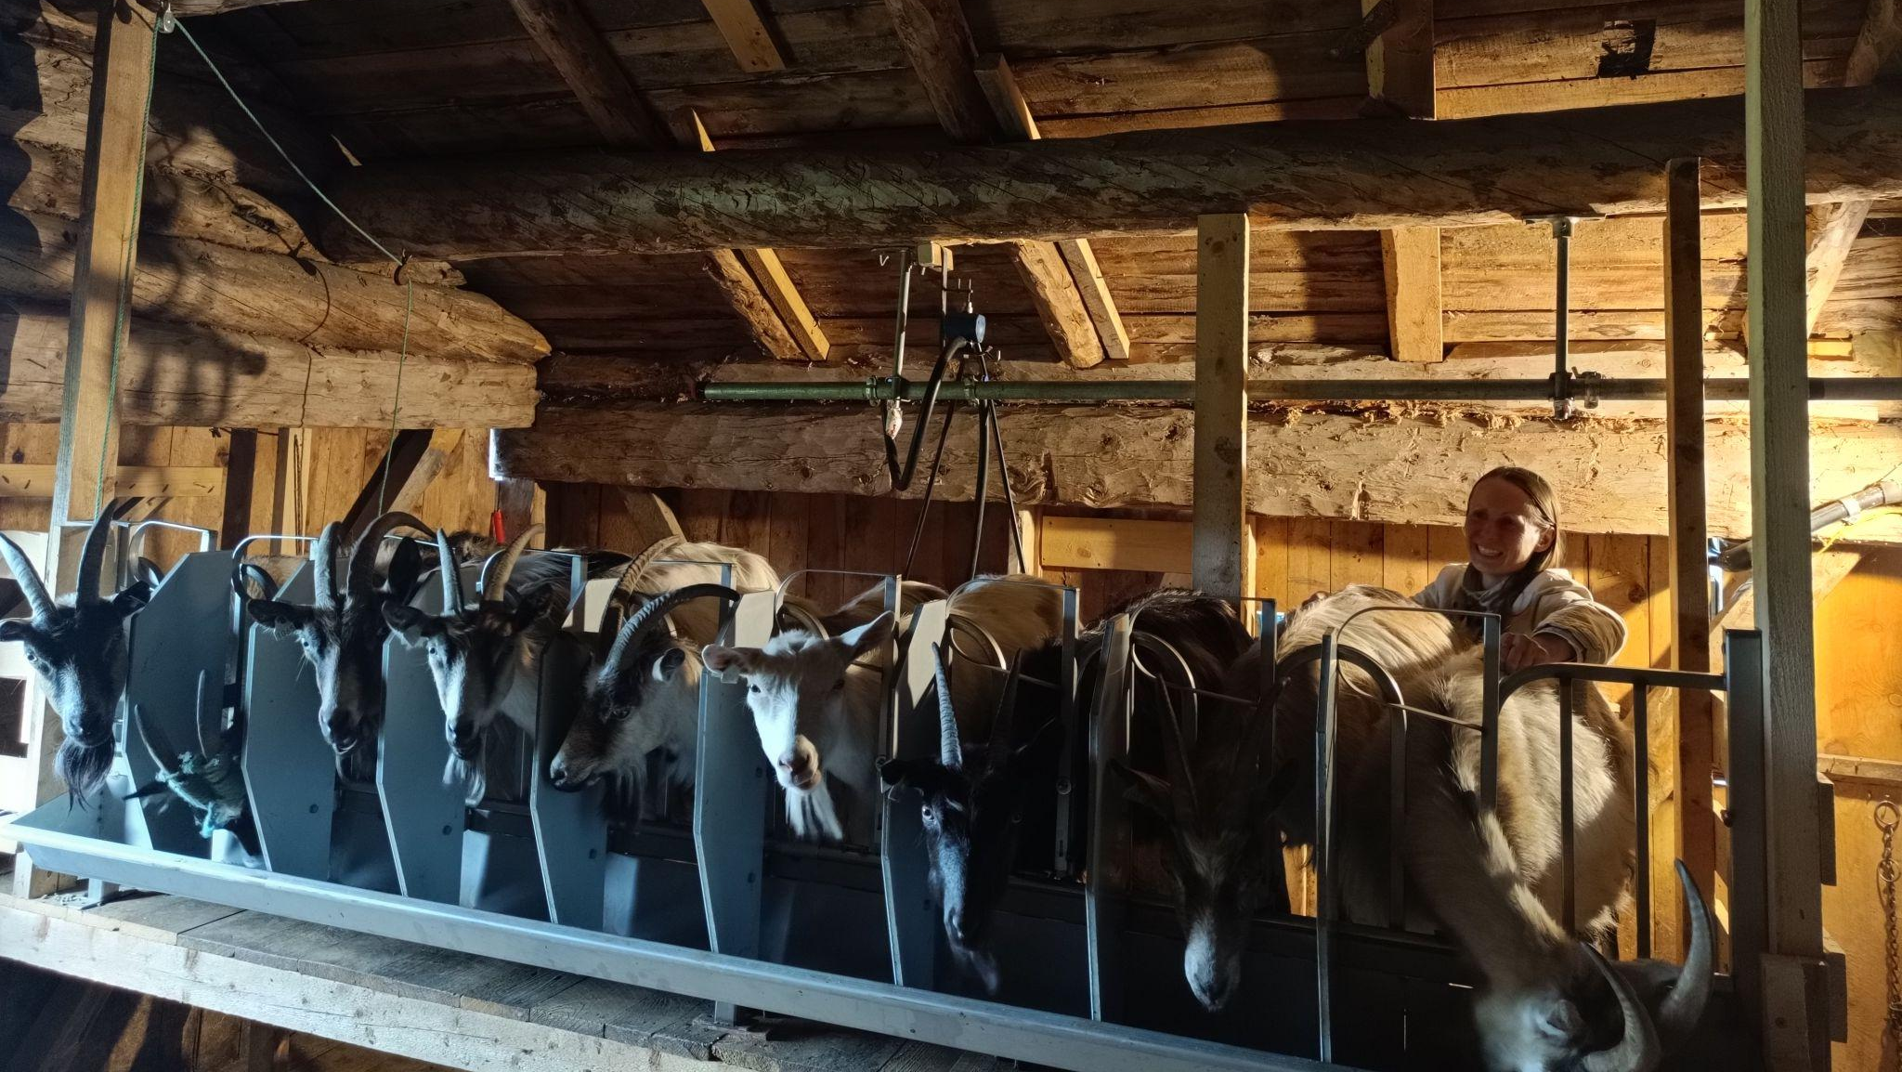
Thank you!
Thank you!

